Slide 1







Tech Panthers
Vaibhav Katkar
Karan Bhavar
Mahesh Thombare
Pournima Ghige
Dharti kabade
-

Slide 2
PROBLEM STATEMENT
heatmap based store placement analysis
A heatmap is a data visualization technique that uses color to represent values in a dataset.
It will show how data is distributed in specific area. Heatmap used for data analysis, Market Analysis.
Types of Heatmaps:-
Website Heatmaps
Show user interactions, such as clicks, scrolls, and mouse movement.
2. Geographical Heatmaps
Represent data intensity over a map (e.g. population density,)

Slide 3
SOLUTION OVERVIEW
To develop a frontend visualization for analyzing store placement using interactive charts and a heatmap. The solution helps businesses make data-driven decisions by presenting insights on population, infrastructure, traffic, store demand, and optimal store locations.
Heatmap Generation:-
Use color-coded heatmaps to highlight potential locations for stores.
Deployment & Continuous Monitoring:-
Use AI-driven recommendations for future expansion strategies.
Decision Support System:-
Provide a dashboard for business insights and strategy optimization.

Slide 4
PROPOSED FEATURES
1.Heatmap Generation & Visualization
Density-Based Color Coding : Indicate high, medium and low
Custom Filters : View heatmaps based on specific factors
2.Store Placement Recommendations
Best Location Suggestions: AI-driven recommendations based on high customer density and minimal competition.
Revenue Projection : Estimate potential sales based on foot traffic and local economic data.
Competitor Risk Analysis : Assess risks of opening a store near strong competitors
3. User Dashboard & Reports
Interactive Dashboard : Visualize heatmaps, reports, and store performance data.

Slide 5
TECH STACK
1.Frontend:
HTML, CSS, javascript
2.Backend:
NODE.JS, Express.js
Node.js and Express.js are used for website backend development because they make it fast, scalable, and efficient. Node.js allows running JavaScript on the server, handling multiple requests asynchronously. Express.js is a lightweight framework that simplifies routing, middleware, and API creation. Together, they help build dynamic, database-driven websites and REST APIs efficiently.
3.Map API --- Openstreetmap
HTML provides the structure.
CSS makes it visually appealing.
JavaScript makes it interactive and functional.

Slide 6
DATA RESOURCES REFERRED
For our analysis, we have utilized various data sources to ensure accuracy and efficiency in decision-making. The key data resources include:
1. Geospatial Data: Google Maps API, OpenStreetMap – Used for location mapping, navigation, and geographic analysis.
2. Demographic Data: Census Data– Provides insights into population distribution, age groups, income i levels, and consumer demographics.
3.Competitor Data: Market Research Reports, Yelp, Google Business Listings – Helps analyze competitor presence, customer
reviews, and market trends.

Slide 7
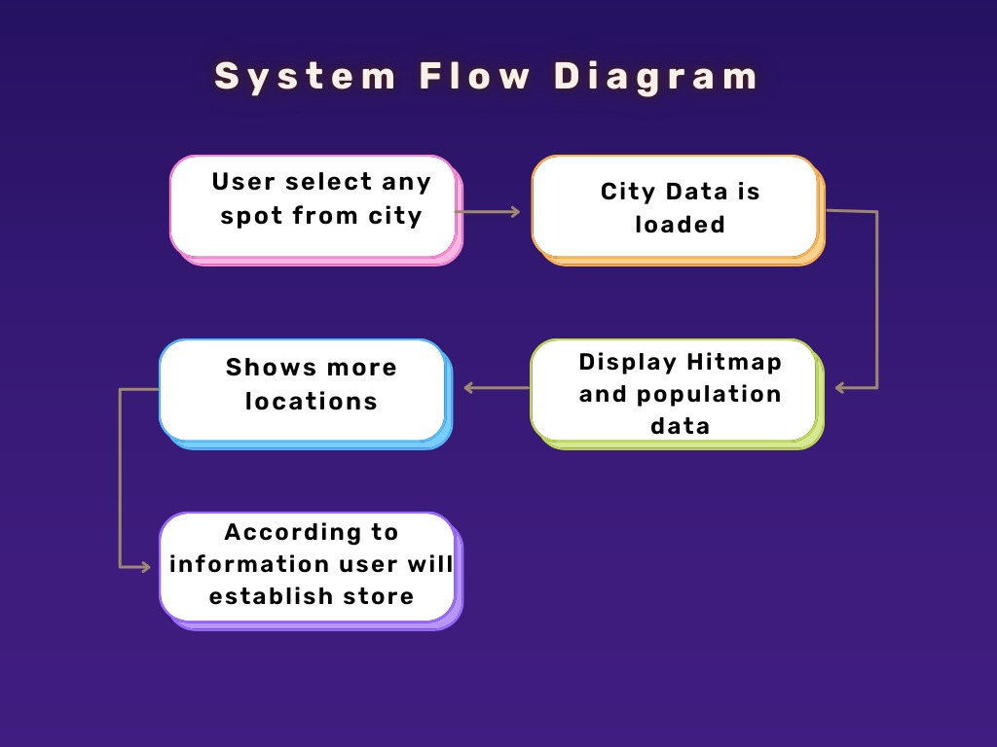
SOLUTION ARCHITECTURE

Slide 8
FUTURE SCOPE & OUTCOMES EXPECTED
Future scope
Enhanced AI & ML Models for Prediction
Integration with IoT & Smart Sensors
Augmented Reality (AR) for Site Visualization
Automated Competitor Impact Analysis
Dynamic Pricing & Marketing Insights
Cloud-Based Scalable Solution
Integration with E-commerce & Omnichannel Strategies
Expected outcome
Accurate Sales Projections : Estimating potential revenue using foot traffic and economic data.
Competitive Advantage : Understanding market positioning by analyzing competitor density and customer preferences.
Enhanced Customer Targeting : Leveraging demographic data to align business strategies with the right audience.
Data-Driven Decision Making : Ensuring strategic planning through real-time and precise analytics.

Slide 9



THANK You...

